Slide 1
Team Member Profile
Dashboard

Slide 2


Accessing & viewing team member profile page
A new team member profile is created when a new user is created in the team member app. As soon as a team member signs up, a profile is created.
This page represents how to access team member profiles
A team member profile can be accessed in 2 ways:
Through the team member page in the dashboard
Through the job profile of an appointment they are on
This flow represents option #1. The team member page in the dashboard shows a list of team members in alphabetical order. This list can be filtered by:
Position
Crew
Chief
Captain
City
Locations
Hours
0-50
51-100
101-150
151-200
201-250
251-300
Earnings
$0-$250
$251-500
$$500-$1000
Rating
Start Date
Status
+ New Appointment
New Tasks
Notifications
Calendars
Members
Customers
Locations
Reporting
Real-Time Dashboard
Search
Type name here...
Filter By
Position
City
Hours
Earnings
Rating
Start Date
Status
TE by Date
First Name
Last Name
Start Date
Position
City
Hours Worked
Total
Earnings
Overall Rating
Phone
#
Corey
Hall
Chief
Starter
412-267-6654
5/1/17
Pittsburgh
234
$4,212
4.8

Slide 3
Accessing & viewing team member profile page (cont’d)
Position
City
Hours
Earnings
Rating
Less than 3
3.1- 4
4 - 5
Start Date
Ascending
Descending
Status
Trainee
Active
Inactive
Simply click on the team members name in the row to access their profile.
Rules:
Most filters can be used in combination with one another.
Team Member profiles can be exported as a whole or with filters active into csv. File
Export will contain ALL profile information except individual jobs
Export will contain a tally of total shifts worked
+ New Appointment
New Tasks
Notifications
Calendars
Members
Customers
Locations
Reporting
Real-Time Dashboard
Search
Type name here...
Filter By
Position
City
Hours
Earnings
Rating
Start Date
Status
TE by Date
Export
First Name
Last Name
Start Date
Position
City
Hours Worked
Total
Earnings
Overall Rating
Phone
#
Corey
Hall
Chief
Starter
412-267-6654
5/1/17
Pittsburgh
234
$4,212
4.8

Slide 4
Team Member Profile Page - Account Status
Account Status
This page represents a team members profile page. Here are the guidelines to determining an account status:
Active means:
Has created an account within the app
Completed Onboarding & is able to take jobs
Has logged into or interacted within the app within the past 60 days
Inactive means
Has created an account within the app and never complete onboarding
Has not logged in or interacted with the app in over 60 days
Trainee means
Has created an account an is in the onboarding process
Member Since
5/17/2017
+ New Appointment
New Tasks
Notifications
Calendars
Members
Customers
Locations
Open Shifts
Rewards Program
Reporting
Real-Time Dashboard
Activate/Deactivate
Corry
Hall
Goals
Interests
Personality Type
Contact
Chief
Starter
Phone #
412-267-6654
Pittsburgh
Tapestry
Email
Chall@gmail.com
Last Login: Date, Time
Upcoming Shifts
Shift History
Stats

Slide 5
Team Member Profile - Elements & Origins
Account Status
Name
Gathered from app sign-in
Location
Based off app sign-in
Tapestry
Manually entered by admin
Bio
Generated from interests and goals
Goals
Provided during onboarding process and updated through app
Personality Type
Provided during onboarding process
Interests
Provided during onboarding process
Contact
Provided during onboarding process
Position & Level
Updated automatically in app while working and engaging
Upcoming Shifts
Updated as new shifts accepted
Shift History
Updated after a completed shift
Stats
Updated periodically as new relevant stats are accrued.
Member Since
5/17/2017
+ New Appointment
New Tasks
Notifications
Calendars
Members
Customers
Locations
Open Shifts
Rewards Program
Reporting
Real-Time Dashboard
Activate/Deactivate
Corry
Hall
Goals
Interests
Personality Type
Contact
Chief
Starter
Phone #
412-267-6654
Pittsburgh
Tapestry
Email
Chall@gmail.com
Last Login: Date, Time
Upcoming Shifts
Shift History
Stats

Slide 6
END
Team Member Profile
Dashboard

Slide 7
User Authorization
Team Member App

Slide 8

Initial screen when opening app
The Home Team Logo
This is the initial screen shown to a user upon opening the app.
After user identifies as customer or team member, they will be redirected to the appropriate login screen.
This path will show the Team Member authorization process.
Welcome to The Home Team!
Customer
Team Member

Slide 9
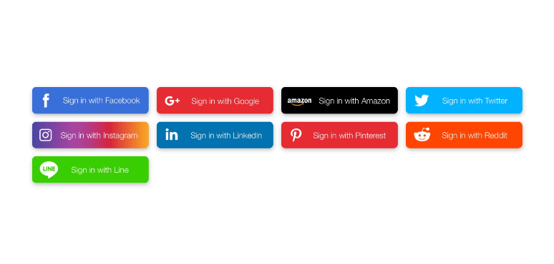
Initial login screen for all team members
The Home Team Logo
This is the initial screen shown to a user who has selected the team member path.
Scenario 1: Existing Team Member
If a team member already has an account they can login using previously selected preferred method
Scenario 2: New Team Member:
If this is a new team member they will go through the general sign-up process.
Welcome to The Home Team!
Your Email
Password
Forgot Password?
Sign In
First time user? Click here to create an account

Slide 10
New Team Member First Time Sign-In
Customer App

Slide 11
General information page and Terms of Service for new user (team member)
Please enter the
information below
This is the screen shown to a new team member who does not have an account.
This page will allow them to enter relevant information to create an account. All information is required.
Rules:
All required fields must be entered.
Email must be confirmed on the backend. (no user involvement)
How did you hear about us options:
Instagram
Facebook
Google
Referral
On-Campus
Other
If “referral” is selected, text box opens where they can type persons name and predictive function will pull up relevant names
If “other” is selected, text field will open for team member to enter additional option
First Name
Last Name
Phone #
Email
DOB
How did you hear about us?
Next

Slide 12
Terms of Service for new user (Team Member)
Please enter the
information below
After team member clicks continue from the previous page, Terms of Service box will appear.
Rules:
Team member must scroll through 10% of TOS before swipe feature is interactive
Team member must swipe entire finger from left to right.
Add an animation once swipe function is complete
Terms of Service
First Name
Last Name
Phone #
Email
Swipe to agree>>>
Next

Slide 13
Login options for new user (Team Member).
Create a username and password or connect social media account
This is the screen shown to a new team member who does not have an account..
This page will allow them to choose how they would like to create an account and log-in..
They can either:
Login with a social media account
Create an account with an email and password
IF they choose to create username and password:
Rules:
Password must be at least 6 characters, be alphanumeric and contain 1 uppercase and 1 lowercase
Email must be a valid email
Verify password box does not appear until after password is entered.
Enter email for username
Create Password
Verify Password
Next

Slide 14
END
User Authorization
Team Member

Slide 15
Team Member App Walkthrough
Team Member App

Slide 16





Upcoming Shift Module
Good [time of day]
[Name] Time to be great!
In the home screen of the team member app, user will be able to see a module which represents their next upcoming shift.
Upon clicking that module, the user will be taken inside the next upcoming shift where they can view and manage shift details.
Points
$$$$

Slide 17
Team Member Home Page
A.
Good [time of day]
[Name] Time to be great!
This page represents the homepage for an existing team member.
Elements:
Rules:
Welcome message
Reflects Team members first name, time of day (morning, afternoon, evening)
Points
Points are generated by completing tasks which admin will generate on the backend in the dashboard
Hourly Rate
Hourly increase reflects progress made from point accumulation on the backend by admin in the dashboard
Progress Bar
Progress bar shows a team where they are in comparison to where they can end up based off of accumulating points
F.
Your next upcoming appointment is [date] at [time]
0
Points
$13.00
Hourly Rate
B.
C.
D.
Current Status
Next Level
E.
Opportunities to earn points
G.
You have [x number] of job notification
H.
Message Board
I.

Slide 18
Team Member Home Page (cont’d)
A.
Good [time of day]
[Name] Time to be great!
This represents the initial home screen for all users on the team member side.
Elements:
Rules (cont’d):
Welcome message
Points
Discounts
Progress Bar
Points & Rewards Program*
This is an accordion style menu that a team can open and learn about activities they can perform to earn more points. Links to activities will be present in this box and generated by admin in the dashboard
Upcoming Appointments*
This will be a clickable element representing the next upcoming shift. Upon clicking it will open up the shift details
Notifications*
Anytime an appointment update or request is made team member will receive notification in home page. It will open up a temporary notification page where a team member can view and approve/deny appointment updates.
F.
Your next upcoming appointment is [date] at [time]
0
Points
$13.00
Hourly Rate
B.
C.
D.
Current Status
Next Level
E.
Opportunities to earn points
G.
You have [x number] of job notification
H.
Message Board
I.

Slide 19
Team Member Home Page (cont’d)
A.
Good [time of day]
[Name] Time to be great!
This represents the initial home screen for all users on the team member side.
Elements:
Rules (cont’d):
Welcome message
Points
Discounts
Progress Bar
Discount Details
Upcoming Appointments
Notifications
Message Board*
These will be messages with links to outside material and resources for customer to check out. Materials will be created and shared within dashboard by admin. Team members will earn points for engaging.
Navigation Bar*
The navigation bar will allow user to navigate to different relevant screens throughout the app
F.
Your next upcoming appointment is [date] at [time]
0
Points
$13.00
Hourly Rate
B.
C.
D.
Current Status
Next Level
E.
Opportunities to earn points
G.
You have [x number] of job notification
H.
Message Board
I.

Slide 20
Good [time of day]
[Name] Time to be great!
Your next upcoming appointment is [date] at [time]
0
Points
$13.00
Hourly Rate
Current Status
Next Level
Opportunities to earn points
You have [x number] of job notification
Message Board

Slide 21
Good [time of day]
[Name] Time to be great!
Video
Your next upcoming appointment is [date] at [time]
0
Points
$13.00
Hourly Rate
Current Status
Next Level
Opportunities to earn points
You have [x number] of job notification
Message Board
Next >>>

Slide 22
E. Points & Rewards Feature
Team Member App

Slide 23
Points & Rewards program in team member app
Good [time of day]
[Name] Time to be great!
This explains and shows the points feature module in the dashboard of the team member app.
The module is accordion style, so when the plus button is clicked, an accordion style menu opens up revealing current ways a team member can earn more points, as well as what those points will lead to.
They will also be able to see tasks/ points earned over the past 30 days.
Certain initiatives will be in text format with hyperlinks to sources which will enable them to complete certain tasks
Initiatives, and their hyperlinks will be assigned in the dashboard and will be specific to:
A location
A certain team member position and/or rank
An individual
Your next upcoming appointment is [date] at [time]
0
Points
$13.00
Hourly Rate
Current Status
Next Level
Opportunities to earn points
Currently: Prospect
Up Next: Rookie
•Complete Home Team App Tutorial - 25 Points
• Complete your Team Member Profile - 50 Points
• Check out The Home Team Newsletter - 30 Point
You have [x number] of job notification

Slide 24
Points & Rewards Program in Dashboard
In Dashboard Admin must be able to create and send out notifications for Points & Rewards program to both customers and team members.
These will be the necessary inputs to create and send a points & rewards program:
Location
Choose which location will receive points and rewards offer
User Type
Customer
Team Member
User Role
Customer
Active
Inactive
Incomplete
Team Member
Prospect
Rookie
Starter
All-Star
Veteran
Legend
Points assigned
Number of points for offer
Text
What will the offer say in the app
Hyperlinks
Hyperlink (to app or website) to click within app and complete task
+ New Appointment
New Tasks
Notifications
Calendars
Members
Customers
Locations
Rewards Program
Reporting
Real-Time Dashboard

Slide 25
F. Upcoming Appointment Module
Team Member App

Slide 26
Upcoming Shift Module
Good [time of day]
[Name] Time to be great!
In the home screen of the team member app, user will be able to see a module which represents their next upcoming shift.
Upon clicking that module, the user will be taken inside the next upcoming shift where they can view and manage shift details.
Your next upcoming appointment is [date] at [time]
0
Points
$13.00
Hourly Rate
Current Status
Next Level
Opportunities to earn points
You have [x number] of job notification
Message Board

Slide 27


Upcoming Shift Module
Job Category
Image of Home OR Map Location
Once a user clicks their upcoming shift, it will take them inside of that shift where they can view/edit and update details.
Distance from location
Est. Drive Time
Team
Date
Start Time - Est Finish Time
Service Type
Job Size
Customer Name
Customer #
Address
Additional Details
Resources

Slide 28
G.Notifications for Upcoming Appointments
Team Member App

Slide 29
Appointment Notifications
Good [time of day]
[Name] Time to be great!
Whenever there are relevant appointment updates, a module will appear indicating such to the user. Upon clicking the module user will be taken to the notifications page
Your next upcoming appointment is [date] at [time]
0
Points
$13.00
Hourly Rate
Current Status
Next Level
Opportunities to earn points
You have [x number] of job notification
Message Board

Slide 30
Notifications Page
Notifications
Notifications
[customer name] has changed their appointment time from [time] to [time]
Once a user clicks the notifications module, they will be taken to the notifications page.
Whenever a team member goes into the notifications page, they will see all job updates that they must acknowledge.
They will swipe right to accept changes and swipe left to swap shift
Type of notifications
Date
Start Time
Hours needed
Pets
Cancellations
[customer name] has changed their appointment date from [date] to [date]
[customer name] has added a [pet] to their job details.
[customer name] has added a [X] more hours to their job.
[customer name] has cancelled their job.

Slide 31
Notifications Page
Notifications
Notifications
[customer name] has changed their appointment time from [time] to [time]
Once a user clicks the notifications module, they will be taken to the notifications page.
Whenever a team member goes into the notifications page, they will see all job updates that they must acknowledge.
They will swipe right to accept changes and swipe left to swap shift
Type of notifications
Date
Start Time
Hours needed
Pets
Cancellations
Next Shift: {Date), [Time]
[customer name] has changed their appointment date from [date] to [date]

Slide 32
H. Home Team Message Board
Team Member App

Slide 33
Home Team Message Board Module
Good [time of day]
[Name] Time to be great!
Admin of The Home Team can send out special messages with links to outside resources where they can access and gain additional points. By clicking the module will open up the specific message
Your next upcoming appointment is [date] at [time]
0
Points
$13.00
Hourly Rate
Current Status
Next Level
Opportunities to earn points
You have [x number] of job notification
Message Board

Slide 34
Home Team Message Board Module
Good [time of day]
[Name] Time to be great!
The Team Member can access the additional resources through the link found within the message board.
Admin can add messages into the message board from Admin Dashboard.
Rules:
Choose location
Choose team member type
Choose rank
Type message
Upload link
Set time to start and expire
Your next upcoming appointment is [date] at [time]
0
Points
$13.00
Hourly Rate
Current Status
Next Level
Opportunities to earn points
You have [x number] of job notification
Message Board
Learn more about the “Law of Attraction” by watching this short video

Slide 35
I. Navigation Bar
Team Member App

Slide 36
Navigation Bar
Good [time of day]
[Name] Time to be great!
The navigation bar is how users will move from page to page throughout the app. The navigation bar consists of 5 components:
The Home Screen
Shifts
Calendar
Notifications
User Profile
The following slides will show the initial screen for all pages.
Your next upcoming appointment is [date] at [time]
0
Points
$13.00
Hourly Rate
Current Status
Next Level
Opportunities to earn points
You have [x number] of job notification
Message Board
1.
2.
3.
4.
5.

Slide 37
Home Page
Customer App

Slide 38
Home Page
Good [time of day]
[Name] Time to be great!
This will be the home page of the app. It will also act as a dashboard where users can receive relevant updates/notifications and take action
Your next upcoming appointment is [date] at [time]
0
Points
$13.00
Hourly Rate
Current Status
Next Level
Opportunities to earn points
You have [x number] of job notification
Message Board

Slide 39
2. Shifts Page
Team Member App

Slide 40

Shifts Page (list view)
Available Shifts My Shifts All Shifts
M T W T F S S
12 13 14 15 16 17 18
This page will allow team members to view available, scheduled and all shifts in a list format.
The “+” button in the top right corner is only available in app for those assigned as “Chief”. This button allows a chief to create a new shift within the app.
September 17th
Job Category
Image of Home OR Map Location
Neighborhood
Load / Unload, 3 Rooms... see more...
Start-End Time
Distance from location
September 18th
Job Category
Image of Home OR Map Location
Neighborhood
Unload, 3 Rooms, 2 Team... see more...
Start-End Time
Distance from location

Slide 41
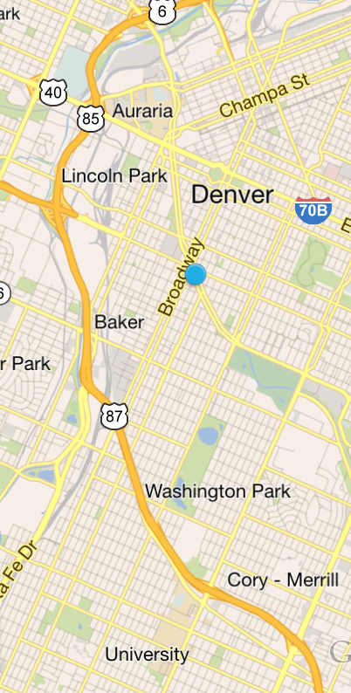


Shifts Page (map view)
Available Shifts My Shifts All Shifts
M T W T F S S
12 13 14 15 16 17 18
This page will allow team members to view available, scheduled and all shifts in a map format.

Slide 42
Viewing Shift (Map View/Available)

Slide 43
Available Shifts (Map View)
Available Shifts My Shifts All Shifts
M T W T F S S
12 13 14 15 16 17 18
When in the “available view” a user can select appointments to view details and accept.
Rules:
When a shift is selected, page will auto-center on shift and bring up an appointment details preview.
If shift has two locations map will auto-center and show both locations.
Team member can accept shift from preview, or click to see full details inside shift.
After a shift has been accepted, all shifts which start 30 minutes before start time or 30 minutes after should disappear from map view.
Job Category
Load / Unload, 3 Rooms... see more...
Image of Home OR Map Location
Start-End Time
Distance from location
Swipe to accept >>>

Slide 44
Available Shifts (Map View, 2 locations)
Available Shifts My Shifts All Shifts
M T W T F S S
12 13 14 15 16 17 18
When multiple locations are involved in a shift, user should always see the final destination where the shift will end
Finish Location
Job Category
Load / Unload, 3 Rooms... see more...
Image of Home OR Map Location
Start-End Time
Distance from location
Swipe to accept >>>

Slide 45
Viewing Shift (Map View/My Shifts)

Slide 46
My Shifts (Map View)
Available Shifts My Shifts All Shifts
M T W T F S S
12 13 14 15 16 17 18
When a shift is selected in “My Shift” view, user will see shift preview and “View Shift” options.
Job Category
Load / Unload, 3 Rooms... see more...
Image of Home OR Map Location
Start-End Time
Distance from location
View Shift

Slide 47
My Shifts (Map View, 2 locations)
Available Shifts My Shifts All Shifts
M T W T F S S
12 13 14 15 16 17 18
When multiple locations are involved in a shift, user should always see the final destination where the shift will end when selecting that shift
Finish Location
Job Category
Load / Unload, 3 Rooms... see more...
Image of Home OR Map Location
Start-End Time
Distance from location
View Shift

Slide 48
Viewing Shift (Map View/All Shifts)

Slide 49

All Shifts (Map View)
Available Shifts My Shifts All Shifts
M T W T F S S
12 13 14 15 16 17 18
When in all shift mode, accepted shifts will be green, accepted shifts will be green. When a shift is selected, it will auto center, show relevant preview and show last location (when applicable).

Slide 50
Viewing Shift (List View / Available Shifts

Slide 51
Shifts Page (Available Shifts & My Shifts)
Available Shifts My Shifts All Shifts
M T W T F S S
12 13 14 15 16 17 18
When viewing shifts on in available view, team members can view shifts and accept by swiping right.
Rules:
When a shift is accepted, shifts starting 30 minutes before start time of shift or 30 minutes after end time of shift will disappear.
Date in date toolbar can be selected, or user can continuously scroll down list and new dates will show once all shifts for current dates have been shown.
When on “My Shifts” no swiping feature is available.
September 17th
Job Category
Image of Home OR Map Location
Neighborhood
Load / Unload, 3 Rooms... see more...
Start-End Time
Distance from location
September 18th
Job Category
Image of Home OR Map Location
Neighborhood
Unload, 3 Rooms, 2 Team... see more...
Start-End Time
Distance from location

Slide 52
Shifts Page (All Shifts)
Available Shifts My Shifts All Shifts
M T W T F S S
12 13 14 15 16 17 18
When viewing shifts in all shifts view, team members can swipe available shifts.
Rules:
Accepted shifts have a color to indicate
Available shifts have no color and can be swiped to accepted
September 17th
Job Category
Image of Home OR Map Location
Neighborhood
Load / Unload, 3 Rooms... see more...
Start-End Time
Distance from location
September 18th
Job Category
Image of Home OR Map Location
Neighborhood
Unload, 3 Rooms, 2 Team... see more...
Start-End Time
Distance from location

Slide 53
Inside a Shift

Slide 54
Inside a shift (available)
Job Category
Image of Home OR Map Location
When a user views the inside of an available shift, the information indicated will show as follows. All relevant information
Details:
Job Category
Job Category is determined by job size.
Location Image
Image of home or location on map if home image unavailable
Team Members
Image of team member profiles and names
Job Details
Customer, # and address is not viewable or clickable
Additional Details
Additional details unclickable
Distance from location
Est. Drive Time
Team
Date
Start Time - Est Finish Time
Service Type
Job Size
Customer Name
Customer #
Address
Additional Details
Swipe to accept

Slide 55
Inside a shift (assigned)
Job Category
Image of Home OR Map Location
When a user views the inside of an accepted shift, the information indicated will show as follows. All relevant information
Details:
Job Category
Job Category is determined by job size.
Location Image
Image of home or location on map if home image unavailable
Team Members
Image of team member profiles and names
Job Details
Customer, # and address is now viewable and clickable
Additional Details
Additional details viewable
Distance from location
Est. Drive Time
Team
Date
Start Time - Est Finish Time
Service Type
Job Size
Customer Name
Customer #
Address
Additional Details
Resources

Slide 56
Elements of a Shift

Slide 57
Inside an accepted shift
Job Category
Image of Home OR Map Location
Upon clicking a shift it will open so user can see all details related to shift.
Upon scrolling they will see an option to view additional images associated with shift
Interactive elements within the appointment:
Team Icon
A pop up opens with team members bio and the option to message / call team members
General Appointment Details (Greyed Box)
A pop up opens with capability for user to request an edit to specific shift details
Additional Details
An accordion style menu opens with additional shift details.
Resources (module never moves)
A resources page opens with additional user resources related to shift
Images icons (see next page)
User can view relevant images to their shift
Distance from location
Est. Drive Time
Team
Date
Start Time - Est Finish Time
Service Type
Job Size
Customer Name
Customer #
Address
Additional Details
Resources

Slide 58
Inside an accepted shift (cont’d)
Job Category
Image of Home OR Map Location
At the bottom of the page, the user can view images related to their shift. By scrolling and clicking the images.
Distance from location
Est. Drive Time
Team
Date
Start Time - Est Finish Time
Service Type
Job Size
Customer Name
Customer #
Address
Additional Details
image
image
image
Resources

Slide 59
Contact Team Member(s)

Slide 60
Contacting team members
Job Category
Image of Home OR Map Location
When a user selects any of the team members in the top corner, a pop-up menu of entire team opens up.
Distance from location
Est. Drive Time
Team
Date
Start Time - Est Finish Time
Service Type
Job Size
Customer Name
Customer #
Address
Additional Details
Resources

Slide 61

Contacting team members
Job Category
Image of Home OR Map Location
Once selected, team members will see other team members profile picture and bio. They can then call or message team members.
Upon selecting the option, phone opens up option to call or text.
First Name,
Last Name
Team Leader
Service Type
Start-End Time
Team Leader
Message / Call
Hi I am a student at [University] studying [Major]. I enjoy [Activity 1] & [Activity 2] My goal while with The Home Team is to [#1 Goal]
I’m here to help so give me a call anytime!
Load / Unload
Start-End Time
Team Leader
Message / Call
Edit
Distance from location
Est. Drive Time
Team
Date
Start Time - Est Finish Time
Service Type
Job Size
Customer Name
Customer #
Address
Date
Start Time - Est Finish Time
Service Type
Job Size
Customer Name
Customer #
Address
Member Since
Avg. Star Rating %
Jobs Completed #
Edit
Call/Text
First Name,
Last Name
Crew Member
Team Member Name
Team Member Name
Hi I am a student at [University] studying [Major]. I enjoy [Activity 1] & [Activity 2] My goal while with The Home Team is to [#1 Goal]
I’m here to help so give me a call anytime!
Additional Details
Additional Details
Team Member Name
Team Member Name
Member Since
Avg. Star Rating %
Jobs Completed #
See Bio
See Bio
Call/Text
Resources

Slide 62
Shift Edits / Edit Requests

Slide 63
Viewing and requesting appointment updates
Job Category
Image of Home OR Map Location
Only Chiefs and Co-Captains can update or request appointment updates. Upon clicking the edit button, appointment details page opens up. Appointment details will be in an editable format.
Distance from location
Est. Drive Time
Team
Date
Start Time - Est Finish Time
Service Type
Job Size
Customer Name
Customer #
Address
Edit
Additional Details
Resources

Slide 64

Viewing and requesting appointment updates
Date
Start Time
Crew Size
Hours Needed
Service Type
Job Size
Appointment Details
<<<Back
Image of Home OR Map Location
This page represents where a user can edit their appointment details. Page should resemble that of the booking process for a customer.
No changes made are final, rather when Chief/Co-Captain makes a requests, notification is sent to customer to approve or deny.
Service Type
Load / Unload
Start-End Time
Team Leader
Message / Call
Date
Start Time - Est Finish Time
Service Type
Job Size
Customer Name
Customer #
Address
Edit
Additional Details
Team Member Name
Team Member Name
See Bio
See Bio
Resources
Submit

Slide 65
Accessing & Viewing Resources Page

Slide 66
Viewing resources page
Job Category
Image of Home OR Map Location
The resources link will take a user to a page that offers additional resources to communicate with customers, corporate and additional resources.
Distance from location
Est. Drive Time
Team
Date
Start Time - Est Finish Time
Service Type
Job Size
Customer Name
Customer #
Address
Additional Details
Resources

Slide 67




Viewing resources page (Crew)
Skip>>>
Job Category
Image of Home OR Map Location
The resources link will take a user to a page that offers additional resources to communicate with customers, corporate and additional resources.
Chat
Swap Request
FAQs
Support
Chat
Swap
Distance from location
Est. Drive Time
Team
Date
Start Time - Est Finish Time
Service Type
Job Size
Customer Name
Customer #
Address
FAQ’s
Support
Additional Details
<<< Back

Slide 68
Resources - Chat Thread

Slide 69
Chat thread (Crew)
Skip>>>
Job Category
Image of Home OR Map Location
The chat thread allows a team member and customer to communicate directly within the app. Team member will click the indicated icon to open up the chat thread.
Chat
Swap
Distance from location
Est. Drive Time
Team
Date
Start Time - Est Finish Time
Service Type
Job Size
Customer Name
Customer #
Address
FAQ’s
Support
Additional Details
<<< Back

Slide 70
Inside the chat thread
<<< Back
Skip>>>
Blah blah hi, this time blah message
When a user is inside the chat thread they can view and send messages directly to the team leader, other crew members and customer.
Rules:
Only Chief and Customer can participate in chat thread prior to day of appointment.
On the day of the appointment crew members can participate in chat thread
Crew members can see chat thread however, cannot participate
Chief and Customer receive push notifications when a new message is received
All chats are dated, time stamped and sender stamped
All chat activity is recorded and logged in the job profile located in the admin dashboard
Admin can access and participate in chat from within the admin dashboard
Chat thread is disabled as soon as the Chief clocks in
First Name Last Initial Date & Time
Blah blah hi, this time blah message
First Name Last Initial Date & Time
Blah blah hi, this time blah message
First Name Last Initial Date & Time
Blah blah hi, this time blah message
First Name Last Initial Date & Time
Blah blah hi, this time blah message
First Name Last Initial Date & Time
Type text here
Keyboard

Slide 71
Resources - Swap Option

Slide 72
Swap Option (Crew)
Skip>>>
Job Category
Image of Home OR Map Location
The swap option allows team members to request a swap with other team members. If team member selects this option, a notification will be sent to all eligible team members who can accept appointment.
Chat
Swap
Distance from location
Est. Drive Time
Team
Date
Start Time - Est Finish Time
Service Type
Job Size
Customer Name
Customer #
Address
FAQ’s
Support
Additional Details
<<< Back

Slide 73
Swap Option (Crew)
Skip>>>
Job Category
Image of Home OR Map Location
Upon clicking a message will appear indicating the implications of a team member making a swap request. If team member chooses yes, they will move on to next page. If “cancel” is selected they will go back to resources page.
Chat
You have requested to swap a shift, you will automatically lose “x” amount of points for placing this request. Would you like to proceed?
Swap
Distance from location
Est. Drive Time
Team
Date
Start Time - Est Finish Time
Service Type
Job Size
Customer Name
Customer #
Address
FAQ’s
Support
Yes
Cancel
Additional Details
<<< Back

Slide 74
Swap Option (Crew)
Skip>>>
Job Category
Image of Home OR Map Location
Team member must agree to swap terms after selecting to move forward
Chat
I UNDERSTAND THAT I AM RESPONSIBLE FOR COMPLETING THIS SHIFT UNTIL REQUESTS IS ACCEPTED. IF REQUEST IS NOT ACCEPTED I MUST PERFORM SHIFT. IF I DO NOT PERFORM SHIFT AND REQUESTS WAS NOT ACCEPTED I UNDERSTAND MY ACCOUNT WILL BE DEACTIVATED INDEFINITELY
Swap
Distance from location
Est. Drive Time
Team
Date
Start Time - Est Finish Time
Service Type
Job Size
Customer Name
Customer #
Address
FAQ’s
Support
Additional Details
SWIPE TO AGREE
<<< Back

Slide 75
Swap Option (Crew)
Skip>>>
Job Category
Image of Home OR Map Location
After confirming they’d like to swap shift, they will be prompted to indicate why they’d like to swap shift.
Chat
Please describe why you’d like to swap shift.
Swap
Distance from location
Est. Drive Time
Team
Type here...
Date
Start Time - Est Finish Time
Service Type
Job Size
Customer Name
Customer #
Address
FAQ’s
Support
Submit
Additional Details
<<< Back

Slide 76
Swap Option (Crew)
Skip>>>
Job Category
Image of Home OR Map Location
The swap option allows team members to request a swap with other team members. If team member selects this option, a notification will be sent to all eligible team members who can accept appointment.
Shift will have a yellow hue in the shift preview in list and map view indicating that swap requests has been made.
Chat
Your requests has been submitted. YOU ARE STILL RESPONSIBLE FOR PERFORMING THIS SHIFT. Once a team member accepts your requests you will be notified and no longer be responsible for performing this shift
Swap
Distance from location
Est. Drive Time
Team
Date
Start Time - Est Finish Time
Service Type
Job Size
Customer Name
Customer #
Address
FAQ’s
Support
Swipe to close
Additional Details
<<< Back

Slide 77
Resources - FAQs

Slide 78
FAQs (Crew)
Skip>>>
Job Category
Image of Home OR Map Location
When a team member selects the FAQ page they will be taken to a webpage within the home team website.
Chat
Cancel Swap
Distance from location
Est. Drive Time
Team
Date
Start Time - Est Finish Time
Service Type
Job Size
Customer Name
Customer #
Address
FAQ’s
Support
Additional Details
<<< Back

Slide 79
Resources - Support

Slide 80
Support Option (Crew)
Skip>>>
Job Category
Image of Home OR Map Location
When support is selected, team member will be taken to a chat thread to communicate with a relevant support member.
If no team member is available, they will be able to send in support requests that will be received in admin dashboard.
Chat
Cancel Swap
Distance from location
Est. Drive Time
Team
Date
Start Time - Est Finish Time
Service Type
Job Size
Customer Name
Customer #
Address
FAQ’s
Support
Additional Details
<<< Back

Slide 81
Support option with live help available
<<< Back
Skip>>>
Blah blah hi, this time blah message
A chat thread will be available to communicate with support team member
First Name Last Initial Date & Time
Blah blah hi, this time blah message
First Name Last Initial Date & Time
Blah blah hi, this time blah message
First Name Last Initial Date & Time
Blah blah hi, this time blah message
First Name Last Initial Date & Time
Blah blah hi, this time blah message
First Name Last Initial Date & Time
Type text here
Keyboard

Slide 82
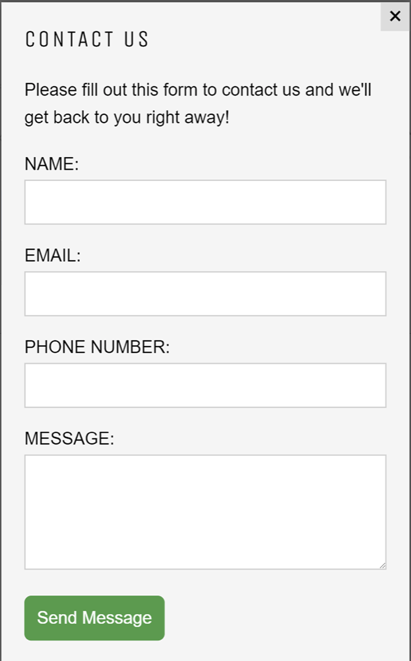
Support option, live help unavailable
Support is currently offline, please submit a contact form below
A message will be submitted that will be received through admin dashboard for a future response.
FAQs

Slide 83
End Crew Resources

Slide 84
Chief Resources

Slide 85




Viewing resources page (Chief)
Skip>>>
Job Category
Image of Home OR Map Location
The resources link will take a user to a page that offers additional resources to communicate with customers, corporate and additional resources.
The Chief will have the following additional resources:
Checklist
Upload photos
Damage report
Checklist
Chat
Distance from location
Est. Drive Time
Team
Date
Start Time - Est Finish Time
Service Type
Job Size
Customer Name
Customer #
Address
Upload Photos
Damage Report
Swap
FAQ’s
Additional Details
Support
Add time
<<< Back

Slide 86
Resources- Checklist

Slide 87
Checklist page for (Chief)
Skip>>>
Job Category
Image of Home OR Map Location
The checklist page where will be where the Chief documents required interactions between themselves and the customer. The checklist page will feature a different set of questions based off proximity to job start time. Checklist will be broken up into 3 sections.
24hrs after accepting
72hrs before shift
Day of shift
Checklist
Chat
Distance from location
Est. Drive Time
Team
Date
Start Time - Est Finish Time
Service Type
Job Size
Customer Name
Customer #
Address
Upload Photos
Damage Report
Swap
FAQ’s
Additional Details
Support
Add time
<<< Back

Slide 88
Checklist page for (Chief)
Skip>>>
Step 1: Introduction
Hi [Customer] my name is [Name] and I will be your team leader. Just wanted to call to introduce myself, confirm your details and lay out our process. Is this a good time for you? Great!
Step 2: Review job details
Review all details for accuracy
Step 3: Take notes on job environment
Hallways, elevators, truck parking etc.
Step 4: Explain Home Team agreement & mission
Our goal is to safely assist you while maintaining integrity of your home and personal belongings
Step 5: Inform of opportunities for discounts
Submit images through app, complete survey in app, take quiz in app
Step 6: Record customer goals, values and experience
Goal of hiring us
Value the most in experience
What could make this experience enjoyable
Within 24hrs of accepting shift:
Confirm details
Introduce self
Discuss process
Working conditions
What the home team agreement is
Submit images
Customer goals
Customer values
Customer experience
Job Category
Image of Home OR Map Location
Step 1: Confirming appointment details
Step 2: Update customer on any relevant changes
Step 3: Inform customer of team members
Step 4: inform customer of schedule and offer additional hours/crew
Step 5: inform customer of discount opportunities
Step 6: ensure customer is prepared
Distance from location
Est. Drive Time
Team
Date
Start Time - Est Finish Time
Service Type
Job Size
Customer Name
Customer #
Address
Within 72hrs of accepting shift:
Confirm details are the same
Inform of any changes
Upsales (hrs, guys)
Timeframe
Discounts opportunities
Preparation
Additional Details
<<< Back

Slide 89
Checklist page for (Chief)
Skip>>>
Step 1: Introduction
Hi [Customer] my name is [Name] and I will be your team leader. Just wanted to call to introduce myself, confirm your details and lay out our process. Is this a good time for you? Great!
Step 2: Review job details
Review all details for accuracy
Step 3: Take notes on job environment
Hallways, elevators, truck parking etc.
Step 4: Explain Home Team agreement & mission
Our goal is to safely assist you while maintaining integrity of your home and personal belongings
Step 5: Inform of opportunities for discounts
Submit images through app, complete survey in app, take quiz in app
Step 6: Record customer goals, values and experience
Goal of hiring us
Value the most in experience
What could make this experience enjoyable
Job Category
Image of Home OR Map Location
Within 24hrs of accepting a shift, the Chief must contact the customer in order to introduce themself, acquire additional details and inform customer of opportunities.
Step 1: In this section of the app, team member will have a script to read from for introduction.
Step 2: Job details relating to specific shift will be present here and chief will review details to ensure accuracy.
Step 3: Chief will have script, detailing what to asks and text box available for customer to respond
Step 4: Chief will have script of home team agreement and outline process from now until completion
Step 5: Chief will have script of each opportunity to explain
Step 6: Chief will have a script and text box to fill in customer response
Distance from location
Est. Drive Time
Team
Date
Start Time - Est Finish Time
Service Type
Job Size
Customer Name
Customer #
Address
Additional Details
<<< Back

Slide 90
Checklist 1 - 24hrs after accepting

Slide 91


Checklist 1 - Step 1
Skip>>>
Job Category
Image of Home OR Map Location
Step 1: Introduction
Hi [Customer] my name is [Name] and I will be your team leader. Just wanted to call to introduce myself, confirm your details and lay out our process. Is this a good time for you?
Distance from location
Est. Drive Time
Team
Date
Start Time - Est Finish Time
Service Type
Job Size
Customer Name
Customer #
Address
Additional Details
<<< Back

Slide 92
Checklist 1 - Step 1 (if not a good time)
Skip>>>
Job Category
Image of Home OR Map Location
Step 1: Introduction
Ok, when would be a good time to reach back out?
Distance from location
Est. Drive Time
Team
Date
Start Time - Est Finish Time
Service Type
Job Size
Customer Name
Customer #
Address
Date
Time
Additional Details
Set Reminder
<<< Back

Slide 93
Checklist 1 - Step 2
Skip>>>
Job Category
Image of Home OR Map Location
Step 2: Review job details
I see we have you for [crew size] for [hours] on [date] at [time] is that accurate? Cool, we’ll be meeting you at [address] and finishing at [address] correct? Ok great.
Update
Distance from location
Est. Drive Time
Team
Date
Start Time - Est Finish Time
Service Type
Job Size
Customer Name
Customer #
Address
Additional Details
<<< Back

Slide 94
Checklist 1 - Step 2 (if update is needed)
Skip>>>
Date
Start Time
Crew Size
Hours Needed
Service Type
Job Size
Appointment Details
Job Category
Image of Home OR Map Location
<<<Back
Image of Home OR Map Location
Step 2: Review job details
I see we have you for [crew size] for [hours] on [date] at [time] is that accurate? Cool, we’ll be meeting you at [address] and finishing at [address] correct? Ok great.
Update
Service Type
Load / Unload
Start-End Time
Team Leader
Message / Call
Distance from location
Est. Drive Time
Team
Date
Start Time - Est Finish Time
Service Type
Job Size
Customer Name
Customer #
Address
Date
Start Time - Est Finish Time
Service Type
Job Size
Customer Name
Customer #
Address
Edit
Additional Details
Additional Details
Team Member Name
Team Member Name
See Bio
See Bio
Resources
<<< Back
Submit

Slide 95
Checklist 1 - Step 3
Skip>>>
Job Category
Image of Home OR Map Location
Step 3: Take notes on job environment
Ok could you please describe for me where the truck will be parked, and what the walk from the home to the truck will look like?
Distance from location
Est. Drive Time
Team
Date
Start Time - Est Finish Time
Service Type
Job Size
Customer Name
Customer #
Address
Type here...
Additional Details
<<< Back

Slide 96
Checklist 1 - Step 4
Skip>>>
Job Category
Image of Home OR Map Location
Step 4: Explain Home Team agreement & mission
Our mission is to create a safe, professional work environment to perform services in while keeping the integrity of your items and areas intact
Distance from location
Est. Drive Time
Team
Date
Start Time - Est Finish Time
Service Type
Job Size
Customer Name
Customer #
Address
Next
Additional Details
<<< Back

Slide 97
Checklist 1 - Step 5
Skip>>>
Job Category
Image of Home OR Map Location
Step 5: Inform of opportunities for discounts
Just so you are aware, you do have an opportunity to earn discounts by completing a customer survey, submitting a video of a walkthrough of your jobsite and many more. Download the home team app today in order to access these opportunities and more
Distance from location
Est. Drive Time
Team
Date
Start Time - Est Finish Time
Service Type
Job Size
Customer Name
Customer #
Address
Next
Additional Details
<<< Back

Slide 98
Checklist 1 - Step 6
Skip>>>
Job Category
Step 6: Record customer goals, values and experience
Last just a few quick questions for myself and the team to be aware of...
Image of Home OR Map Location
What is the main goal we can accomplish for you?
Type here...
Distance from location
Est. Drive Time
Team
Date
Start Time - Est Finish Time
Service Type
Job Size
Customer Name
Customer #
Address
What do you value most in a service experience?
Type here...
Additional Details
How can we make this experience awesome for you??
Type here...
Next
<<< Back

Slide 99
Checklist 1 - conclusion
Skip>>>
Job Category
Image of Home OR Map Location
Conclusion
Awesome well that’s it! This is my personal number if you need to contact me, also feel free to message me directly through the app for any questions, comments or updates. In the meantime good luck preparing for your upcoming transition!
Distance from location
Est. Drive Time
Team
Date
Start Time - Est Finish Time
Service Type
Job Size
Customer Name
Customer #
Address
Submit
Additional Details
<<< Back

Slide 100
Checklist 2- 72hrs before shift

Slide 101
Checklist 1 - Step 1
Skip>>>
Job Category
Image of Home OR Map Location
Step 1: Introduction
Hi [Customer] it’s [Name] with The Home Team your team leader. Just wanted to call to check in prior to your appointment.. Is this a good time for you?
Distance from location
Est. Drive Time
Team
Date
Start Time - Est Finish Time
Service Type
Job Size
Customer Name
Customer #
Address
Additional Details
<<< Back

Slide 102
Checklist 2- Step 1 (if not a good time)
Skip>>>
Job Category
Image of Home OR Map Location
Step 1: Introduction
Ok, when would be a good time to reach back out?
Distance from location
Est. Drive Time
Team
Date
Start Time - Est Finish Time
Service Type
Job Size
Customer Name
Customer #
Address
Date
Time
Additional Details
Set Reminder
<<< Back

Slide 103
Checklist 2- Step 2
Skip>>>
Job Category
Image of Home OR Map Location
Step 2: Confirm Details
I see we have you down for [crew size] on [date] at [time] with a starting address of [location 1] ending at [location 2] is that all still accurate?
Update
Distance from location
Est. Drive Time
Team
Date
Start Time - Est Finish Time
Service Type
Job Size
Customer Name
Customer #
Address
Additional Details
<<< Back

Slide 104
Checklist 2 - Step 3
Skip>>>
Job Category
Image of Home OR Map Location
Step 3: Team & ETA
Great. Looks like our arrival window will be between [time] and [time]. Your team will be [team members name(s)] and myself helping. Based off of similar jobs, we’d recommend an additional team member to ensure we complete the job in the allotted time. Would you want to add another team member or extend your appointment?
Update
Distance from location
Est. Drive Time
Team
Date
Start Time - Est Finish Time
Service Type
Job Size
Customer Name
Customer #
Address
Additional Details
<<< Back

Slide 105
Checklist 2 - Step 4
Skip>>>
Job Category
Image of Home OR Map Location
Step 4: Inform of opportunities for discounts
Just so you are aware, you do have an opportunity to earn discounts by completing a customer survey, submitting a video of a walkthrough of your jobsite and many more. Download the home team app today in order to access these opportunities and more
Distance from location
Est. Drive Time
Team
Date
Start Time - Est Finish Time
Service Type
Job Size
Customer Name
Customer #
Address
Next
Additional Details
<<< Back

Slide 106
Checklist 2 - Step 3
Skip>>>
Job Category
Image of Home OR Map Location
Step 5: Preparedness
On move day the essentials to being prepared are:
Having all boxes closed and taped shut
Having all furniture disassembled
Having all pathways cleared.
Knowing this On a scale from 1-10 how prepared would you say you are?
Distance from location
Est. Drive Time
Team
Date
Start Time - Est Finish Time
Service Type
Job Size
Customer Name
Customer #
Address
Additional Details
<<< Back

Slide 107
Checklist 2 - Step 5
Skip>>>
Job Category
Image of Home OR Map Location
If customer says anything under a 9, if customer rates a 9 or above, go to completion screen
Step 5: Preparedness
What areas do you still need more time to prepare?
Boxes
Pathways
Furniture
Distance from location
Est. Drive Time
Team
Date
Start Time - Est Finish Time
Service Type
Job Size
Customer Name
Customer #
Address
Submit
Additional Details
<<< Back

Slide 108
Checklist 2 - Step 6
Skip>>>
Job Category
Image of Home OR Map Location
Step 6: Explain Home Team agreement & mission
Great well we are all set! Again feel free to call me for anything at all. I’ll reach out the day of to let you know our eta. In the meantime check out the app, earn some discounts and we look forward to working with you!
Distance from location
Est. Drive Time
Team
Date
Start Time - Est Finish Time
Service Type
Job Size
Customer Name
Customer #
Address
Submit
Additional Details
<<< Back

Slide 109
Resources- Uploading Photos

Slide 110
Uploading photos of job-site activities
Skip>>>
Job Category
Image of Home OR Map Location
This feature will allow chiefs to upload photos of job site and job site activity to submit to corporate.
This feature is enabled once the Chief clocks in, however is in-accessible until Chief clocks in.
Checklist
Chat
Distance from location
Est. Drive Time
Team
Date
Start Time - Est Finish Time
Service Type
Job Size
Customer Name
Customer #
Address
Upload Photos
Damage Report
Swap
FAQ’s
Additional Details
Support
Add time
<<< Back

Slide 111
Uploading photos of job-site activities
Skip>>>
Upload section for photos.
Chief can upload multiple photos. Once a photo is uploaded Chief must tag the photo to a certain category. They will then have option to leave comment. After submission they can then upload additional photos through same process
Rules:
Photo Tags:
Team Photo
Quality Work
Team at work
All photos are added to job profile in the dashboard
All activities are logged within dashboard activity log in job profile
<<< Back

Slide 112
Resources- Damage Report

Slide 113
Damage Report
Skip>>>
Job Category
Image of Home OR Map Location
If ever there are any issues on a job-site Chief can create and submit a damage report of the incident.
Checklist
Chat
Distance from location
Est. Drive Time
Team
Date
Start Time - Est Finish Time
Service Type
Job Size
Customer Name
Customer #
Address
Upload Photos
Damage Report
Swap
FAQ’s
Additional Details
Support
Add time
<<< Back

Slide 114
Damage Report Feature Details
Skip>>>
We’re sorry for the inconvenience. Please submit a damage report and we will reach out within 24hrs.
Upon selecting the damage report option, chief will be able type in a message indicating what happened in a text field.
Upon typing the “next” option will appear for user to go on to the next prompt.
Please type what happened here
Next
<<< Back

Slide 115
Damage Report Feature Uploading Images
Skip>>>
On this page chief can upload as many images as necessary. Chief can then add comments to a picture prior to uploading it in order to detail damage related to the picture.
Please upload all relevant images
Next
<<< Back

Slide 116
Damage Report Feature Completion
Skip>>>
Text recapping what happened
On this page, chief will view image details and text prior to submitting. Once chief reviews details they can hit submit and the report will be sent.
Rules:
Damage report will be sent and attached to the job profile
Report submission will be logged in the activity log
Admin receives a notification of new damage report in the dashboard
Edit
Images to scroll
Add more images
Submit
<<< Back

Slide 117
Resources- Add Time

Slide 118
Add Time
Skip>>>
Job Category
Image of Home OR Map Location
Sometimes an appointment may need to be extended and we do not have the customers card on file. If a customer's card is not on file the “add time” icon should be present (third party jobs)
When this option is selected, team member will place deposit on card of $1 for future billing, and extend out appointment.
Rules:
Add time icon should only appear if no payment details are on file
Checklist
Chat
Distance from location
Est. Drive Time
Team
Date
Start Time - Est Finish Time
Service Type
Job Size
Customer Name
Customer #
Address
Upload Photos
Damage Report
Swap
FAQ’s
Additional Details
Support
Add time
<<< Back

Slide 119
Add Time
Are additional Team Members Needed?
How Many?
What address?
Payment Details
Add Time
<<<Back
Image of Home OR Map Location
New Shift
When a customer needs more time, Chief will complete the following form.
Additional team members needed?
Dropdown menu
Yes or No
How many?
Drop down menu
1-3
What address
Address field with map
Rules:
If chief selects yes to “more team members are needed” then all other questions will be activated, if not Chief will go straight to payment details
If “New Shift” option is selected, Chief will be taken through the new shift process. Customers general information will auto populate (name, #, email)
Service Type
Load / Unload
Start-End Time
Team Leader
Message / Call
Date
Start Time - Est Finish Time
Service Type
Job Size
Customer Name
Customer #
Address
Edit
Additional Details
Name on Card
Team Member Name
Team Member Name
Card #
See Bio
See Bio
Billing Zip
CVC #
Resources
Submit

Slide 120
Creating a new shift (Chiefs Only)

Slide 121
Shifts Page (list view)
Available Shifts My Shifts All Shifts
M T W T F S S
12 13 14 15 16 17 18
This page will allow team members to view available, scheduled and all shifts in a list format.
The “+” button in the top right corner is only available in app for those assigned as “Chief”. This button allows a chief to create a new shift within the app.
September 17th
Job Category
Image of Home OR Map Location
Neighborhood
Load / Unload, 3 Rooms... see more...
Start-End Time
Distance from location
September 18th
Job Category
Image of Home OR Map Location
Neighborhood
Unload, 3 Rooms, 2 Team... see more...
Start-End Time
Distance from location

Slide 122
Creating a shift details
Service Type
Job Type
Date & Time
Hours
Crew Size
Job Size
New Shift
<<<Back
Image of Home OR Map Location
When creating a new shift, chief will be taken through relevant prompts per screen.
Service Type
Drop down menu
Helping hand
In-house move
Loading / Unloading
Job Type
Drop down menu
Loading
Unloading
Load & Unload
Date & Time
Calendar option
Hours
Drop down menu
1-8 (depending on time)
Crew Size
Drop down menu
1-5
Job Size
Drop down menu
Studio
1 - 5 bed
Service Type
Load / Unload
Start-End Time
Team Leader
Message / Call
Date
Start Time - Est Finish Time
Service Type
Job Size
Customer Name
Customer #
Address
Edit
Additional Details
Team Member Name
Team Member Name
See Bio
See Bio
Resources
Next

Slide 123
Creating a shift details
Furniture
Boxes
Stairs
Address
Customer First Name
Customer Last Name
Customer #
Customer Email
<<<Back
New Shift
Image of Home OR Map Location
Details cont’d
Furniture
Drop down menu
Options from booking process
Boxes
Drop down menu
Options from booking process
Stairs
Drop down menu
Options from booking process
Address
Predictable address & map
Customer First Name
Text field
Customer Last Name
Text field
Customer #
Text field
Customer E-mail
Text field
Service Type
Load / Unload
Start-End Time
Team Leader
Message / Call
Date
Start Time - Est Finish Time
Service Type
Job Size
Customer Name
Customer #
Address
Edit
Additional Details
Team Member Name
Team Member Name
See Bio
See Bio
Resources
Next

Slide 124
Creating a shift details
Pets
Parking Instructions
Security Instructions
Message to The Team
Payment Details (optional)
New Shift
<<<Back
Image of Home OR Map Location
Details cont’d
Pets
Dropdown menu
Parking Instructions
Text field
Security Instructions
Text field
Message to the team
Text field
Once a new shift is submitted it will be available in the app to all team members. An appointment will also be created in the app for the customer.
Service Type
Load / Unload
Start-End Time
Team Leader
Message / Call
Date
Start Time - Est Finish Time
Service Type
Job Size
Customer Name
Customer #
Address
Edit
Additional Details
Name on Card
Team Member Name
Team Member Name
Card #
See Bio
See Bio
Billing Zip
CVC #
Resources
Submit

Slide 125
End
2. Shifts Page
Team Member App

Slide 126
3. Calendar
Team Member App

Slide 127
Calendar Page
Good [time of day]
[Name] Time to be great!
Click the indicated icon will take user to the calendar page
Your next upcoming appointment is [date] at [time]
0
Points
$13.00
Hourly Rate
Current Status
Next Level
Opportunities to earn points
You have [x number] of job notification
Message Board

Slide 128
Calendar Page - Go Live scheduling
Skip>>>
Tomorrow
12th
Monday
13th
Tuesday
14th
Wed
15th
8
This page will be used by team members to create their calendar and indicate their availability. They can swipe to the left and see all future dates for the next 15 days.
They will simply swipe down from a start time to a stop time indicating when they are available.
Times they indicate they are available we will auto schedule them for shifts that are booked during that time.
Rules:
Shifts will be assigned based off of position, rank, hours worked and overall rating.
On an auto assigned shift, the first team member will be the blended best of the above indicated criteria, the next team member will be the blended worst and that pattern will repeat until shift is staffed.
There is no limit to how long a team member can go live in a day.
When a team member goes live they earn additional pay of $2 and 50% more points per shift.
Scheduling is by the half an hour increments
am
9
am
10
am
11
am
12
pm
1
pm
2
pm
3
pm
4
pm
5
pm
6
pm
<<< Back

Slide 129
Calendar Page - Go Live scheduling
Skip>>>
Tomorrow
12th
Monday
13th
Tuesday
14th
Wed
15th
8
By clicking the lightning bolt icon in the corner, team members can access the “Go Live Now” feature.
am
9
am
10
am
11
am
12
pm
1
pm
2
pm
3
pm
4
pm
5
pm
6
pm
<<< Back

Slide 130


Calendar Page - Go Live Now
Skip>>>
Go Live now allows team members to make themselves available for on demand work. When a customer makes a same day or on-demand requests it will go to members who are “Live”.
“Going Live” is activated by hitting the lighting bolt. You can end going live by also clicking the lighting bolt.
Rules:
When a member is live they earn 10 points an hour
When assigned to a live shift they earn double the points
While live team members pay increases by $1/hr. From whatever their initial pay is to a maximum of $21/hr
Live feature is automatically deactivated after 8pm same day
<<< Back

Slide 131
End
3. Calendar Page
Team Member App

Slide 132
4. Notifications & Community Feed
Team Member App

Slide 133
Home Page
Good [time of day]
[Name] Time to be great!
This will be the home page of the app. It will also act as a dashboard where users can receive relevant updates/notifications and take action
Your next upcoming appointment is [date] at [time]
0
Points
$13.00
Hourly Rate
Current Status
Next Level
Opportunities to earn points
You have [x number] of job notification
Message Board

Slide 134
Notifications Page
Notifications Community Feed
[customer name] has changed their appointment time from [time] to [time]
This page will allow users to see relevant notifications as well as check out The Home Team news feed which will have relevant post and content that users can engage in and interact with.
Rules:
Only updates that could potentially change a team members schedule or affect their work environment are placed in the notifications page.
Start time
Number of hours
Date change
Cancellations
Pets
All notifications must be cleared by the end of the day by swiping right to accept or swiping left to place swap request.
Clicking on an appointment will open up the shift details
[customer name] has changed their appointment date from [date] to [date]
[customer name] has added a [pet] to their job details.
[customer name] has added a [X] more hours to their job.
[customer name] has cancelled their job.

Slide 135

Community Feed
Notifications Community Feed
City
On this page users will be able to see and engage with Home Team posts by other customers and team members.
Upon the team member selecting the plus button they can create a post
Rules:
Feed is available for up to 30 days worth of posts
City is based off of the city user has identified themselves in
Tags are taken from the tag section when images are posted
Comments are public
Image
Tag
Caption
Like
Likes 18
Comment
View Comments
Report
City
Image
Tag
Caption
Like
Likes 18
Comment
View Comments

Slide 136
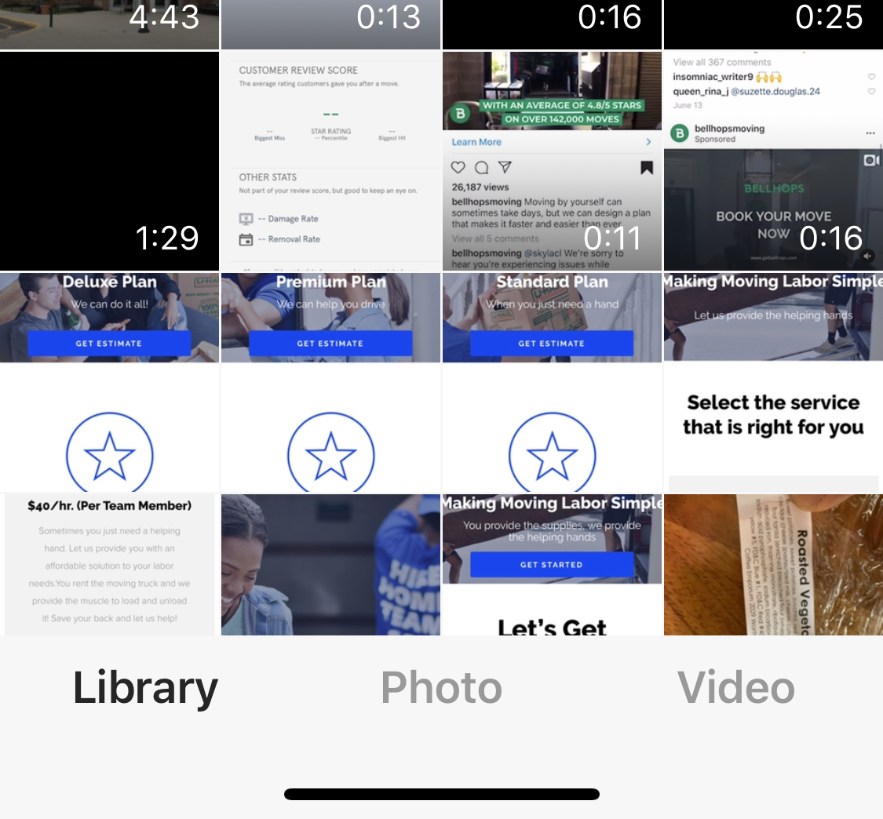
Community Feed Posting Process
Cancel
Next
Selected image shows up here
User will choose an image and click next

Slide 137
Community Feed
Back
Selected image shows up here
User will then write a caption and select a predetermined tag(s) to their posting
Write Caption
Select Tags
Post

Slide 138
END
4. Notifications & Community Feed
Team Member App

Slide 139
5. Profile & Settings
Team Member App

Slide 140
Home Page
Good [time of day]
[Name] Time to be great!
This will be the home page of the app. It will also act as a dashboard where users can receive relevant updates/notifications and take action
Your next upcoming appointment is [date] at [time]
0
Points
$13.00
Hourly Rate
Current Status
Next Level
Opportunities to earn points
You have [x number] of job notification
Message Board

Slide 141
User Profile & Settings
First name
Last Name
From this page a user can manage their profile, personal information and communicate with corporate.
Position
Rank
FL0000
Referral Code
Account Settings
Personal Information
Metrics
Team
Get Help
Give Feedback
Resources
Terms of Service
Log Out

Slide 142
Account Settings
Team Member

Slide 143
Account Settings
First name
Last Name
On this page a user an edit username, password and additional information by selecting the indicated area.
Username and password,
General page to update username and password
Location
Page where team member can select what location they want to receive and see job notifications
Address
User can view and update personal shipping address
Hobbies
User can update hobbies
Goals
User can update goals
Notifications
User can determine notifications received and type
Account Settings
Username & Password
Location
Address
Hobbies
Goals
Notifications

Slide 144
Team
Team Member

Slide 145
Account Settings
First name
Last Name
On this page a user can view what team they are on, see it’s Captain and see other team members. Team members can request a trade at anytime.
Team
Current Team: Name
Team Captain: Name
Team Members:
Name
Name
Name
Name
Request a Trade

Slide 146
Personal Information
Team Member

Slide 147
Personal Information
First name
Last Name
From this page a user can update their personal information. By clicking “edit” all information becomes editable. “Edit” turns into “save” when editing information. Once information is saved, page goes back to original settings with updated information.
Personal Information
First Name
Last Name
Phone Number
Email
Edit

Slide 148
Metrics
Team Member

Slide 149
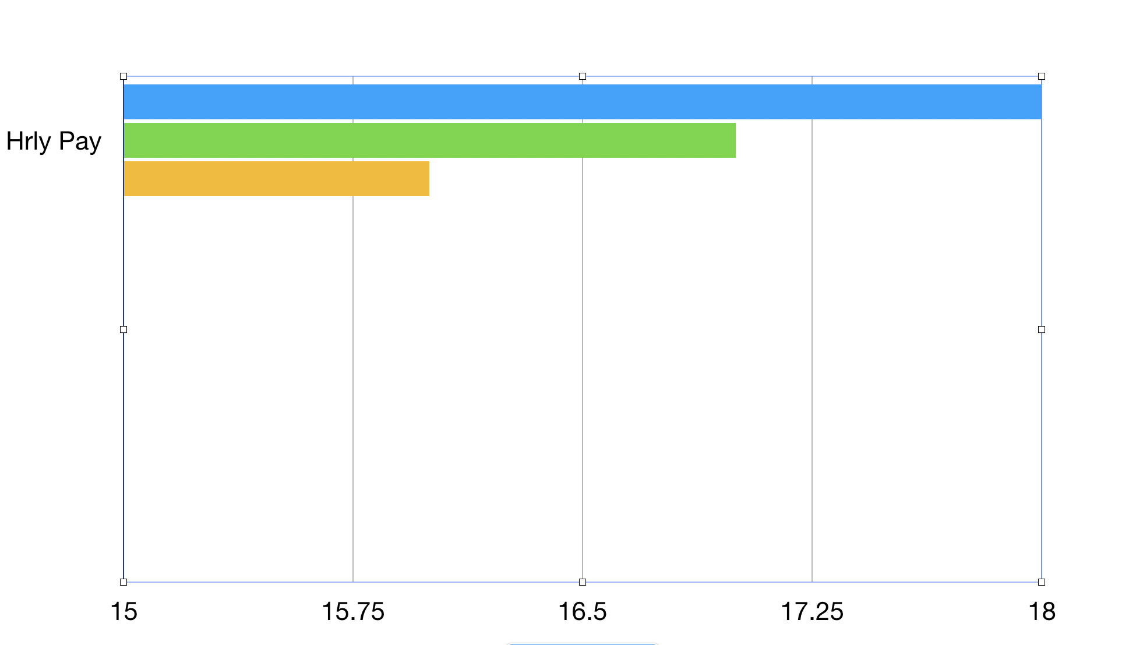
Metrics Page
Metrics
My Metrics Team Metrics
Me
Local Team Members
National Team Members
On this page a user will be able to see their metrics compared to local and national team members. Metrics will include:
Total Earnings*
0-12,000
Total Hrs Worked
0-6000
Total Shifts Completed*
0-900
Total Points Earned
0-100000
Current Hourly Rate
13-22
Team Rating
0-5
Customer Rating
0-5
Overall Rating*
0-5
Total Points Lost
0-30000
Metrics with stars will have a summary sentence indicating when they are likely to hit a milestone.
User can also see exact same stats from a team metrics view as indicated above.
Hourly Pay
Currently you are earning $x per hour. That is x% above/below local team members and x% above below the national average. At your current pace you’ll earn $x amount by [date]
Total Hours Worked
Currently you are earning $x per hour. That is x% above/below local team members and x% above below the national average

Slide 150
Get Help
Team Member

Slide 151
Get Help
<<< Back
Skip>>>
Blah blah hi, this time blah message
The Get Help page will take a user to a live chat page if available. If not, user will be taken to a general “contact us” page where they can submit their inquiry. There will also be a link to our FAQs page found on our website.
First Name Last Initial Date & Time
Blah blah hi, this time blah message
First Name Last Initial Date & Time
Blah blah hi, this time blah message
First Name Last Initial Date & Time
Blah blah hi, this time blah message
First Name Last Initial Date & Time
Blah blah hi, this time blah message
First Name Last Initial Date & Time
Type text here
Keyboard

Slide 152
Get Help
The Get Help page will take a user to a live chat page if available. If not, user will be taken to a general “contact us” page where they can submit their inquiry. There will also be a link to our FAQs page found on our website.
FAQs

Slide 153
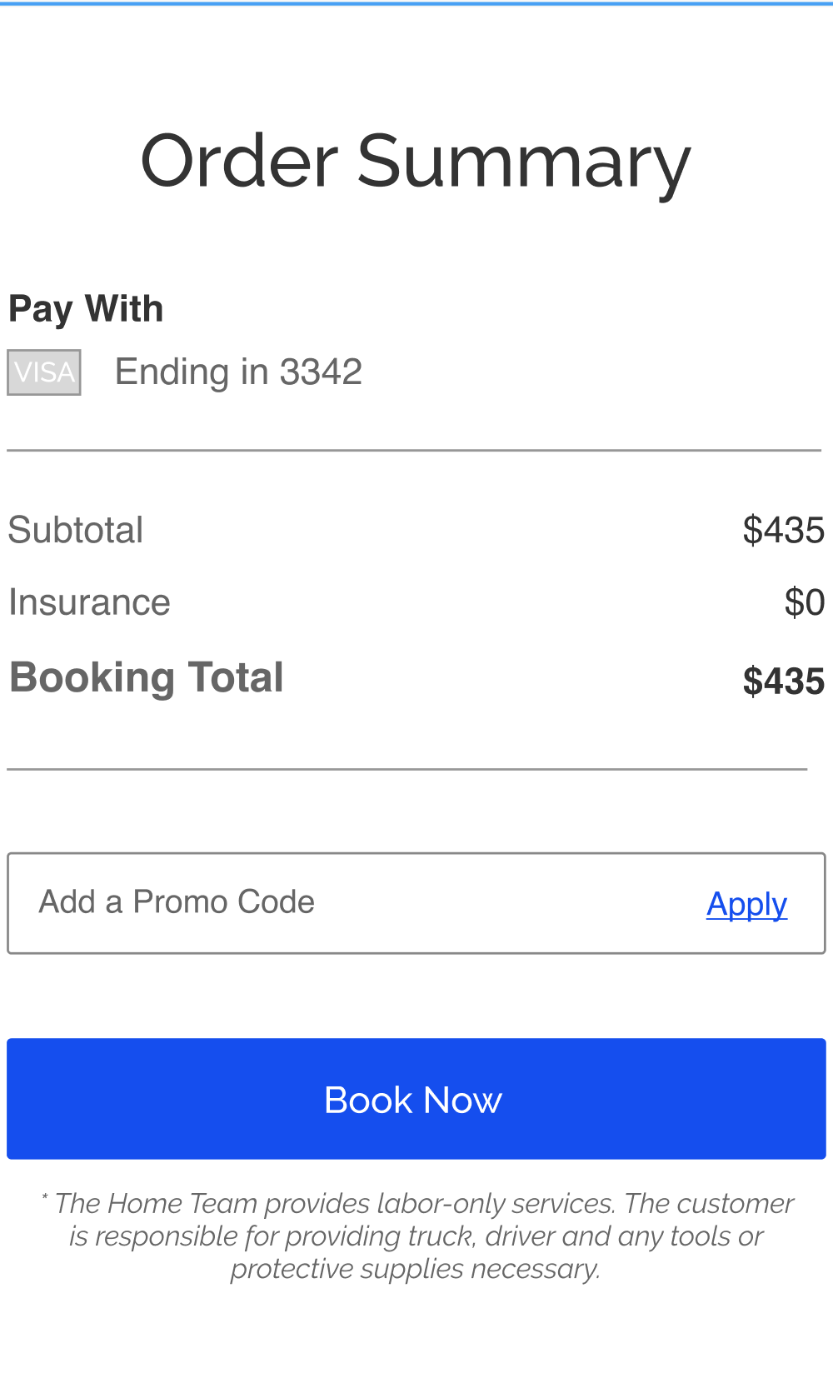
Get Help
The Get Help page will take a user to a live chat page if available. If not, user will be taken to a general “contact us” page where they can submit their inquiry. There will also be a link to our FAQs page found on our website.

Slide 154
Feedback
Team Member

Slide 155
Feedback Page
First name
Last Name
When a user selects the feedback option, a typeform will populate within the app.
Position
Rank
FL0000
Referral Code
Account Settings
Personal Information
Metrics
Get Help
Give Feedback
Resources
Terms of Service
Log Out

Slide 156
Resources
Team Member

Slide 157
Resources Page
First name
Last Name
When a user selects the resources option, they will be redirected to a webpage that has links to all resources.
Position
Rank
FL0000
Referral Code
Account Settings
Personal Information
Metrics
Get Help
Give Feedback
Resources
Terms of Service
Log Out

Slide 158
END
5. Profile & Settings
Team Member App

Slide 159
Notification and Feed Page
Good [time of day]
[Name] Time to be great!
Clicking the indicated icon will take user to the notifications and team feed page
Your next upcoming appointment is [date] at [time]
0
Points
$13.00
Hourly Rate
Current Status
Next Level
Opportunities to earn points
You have [x number] of job notification
Message Board

Slide 161
Pre-Shift Acknowledgement
Team Member

Slide 162
Pre-Shift Acknowledgement
Good [time of day]
[Name] Time to be great!
One hour prior to a shift, team members must acknowledge they will still be participating on the shift. This is done by an acknowledgement message that auto populates an hour before the job.
Upon opening the app this is the only screen a team member is able to see until they indicate if they will be on shift or not.
Rules
If they indicate yes, nothing else is done.
If they indicate no, or do not indicate within 30 minutes of shift, the shift is sent to all available workers in the area for them to accept.
Your next upcoming appointment is [date] at [time]
Your shift for [Name] starts in [Countdown]. Please acknowledge you are still good to go for this job
0
Points
$13.00
Hourly Rate
Current Status
Next Level
Good to go!
Opportunities to earn points
I can’t make it
You have [x number] of job notification
Message Board

Slide 163
Pre-Shift Flow
Team Leader

Slide 164
Pre-Shift Acknowledgement
Good [time of day]
[Name] Time to be great!
Team member is able to access upcoming shift from home page or shift list page.
Your shift for [Customer] is about to start! Click here to clock-in
0
Points
$13.00
Hourly Rate
Current Status
Next Level
Opportunities to earn points
You have [x number] of job notification
Message Board

Slide 165
Clocking In
Job Category
Image of Home OR Map Location
Team leaders will see a button to clock in 30 minutes prior to the start of a shift. This will be a floating button that is above the resources button.
Rules:
If team leader is not clocked in 5 minutes prior to shift, option appears for general team members to clock in
Upon clicking the clock-in.
Distance from location
Est. Drive Time
Team
Date
Start Time - Est Finish Time
Service Type
Job Size
Customer Name
Customer #
Address
Additional Details
Clock In/Out
Resources

Slide 166
Clocking In (Cont’d)
Job Category
Image of Home OR Map Location
Once team leader clicks “clock-in”, modal pops up. This modal allows option for team leader to clock in each team member (including themself).
Once team leader clocks team member in, “clock-in” option changes to “clock-out”
If all team members are present, team leader can simply click “Clock In All” option.
In order to exit modal, team member will hit “back” button
<<<Back
Corey Hall (Me)
Chief
Distance from location
Est. Drive Time
Team
Clock In
Date
Start Time - Est Finish Time
Service Type
Job Size
Customer Name
Customer #
Address
Mark Strong
Crew
Clock In
Additional Details
Clock In All
Next
Resources

Slide 167

Pre-Shift Form
Job Category
Image of Home OR Map Location
Once team member(s) have been clocked in, team leader begins the pre-shift form.
Clock-In
Intro &
Walkthrough
Game Plan
Distance from location
Est. Drive Time
Team
Date
Start Time - Est Finish Time
Service Type
Job Size
Customer Name
Customer #
Address
Awesome, you’re team is clocked in. Let’s go through the Pre-Shift prompts. Click “next” to get started.
Additional Details
Next
Resources

Slide 168
Intro & Walkthrough Instructions
Job Category
Image of Home OR Map Location
Team Leader will see a brief script. Once introduction script has been read, team leader will move on to next prompt.
Clock-In
Intro &
Walkthrough
Game Plan
Distance from location
Est. Drive Time
Team
Introduce the team and yourself to customer and politely ask for a tour of the job-site
Date
Start Time - Est Finish Time
Service Type
Job Size
Customer Name
Customer #
Address
“Hi I’m [First & Last Name] and I’ll be your team leader. If we could, let’s start of with a walkthrough of the job-site and areas we’ll be working in.”
Additional Details
Next
Resources

Slide 169
Intro & Walkthrough Instructions (cont’d)
Job Category
Image of Home OR Map Location
As walkaround is happening, team member will be able to snap photos of job-site and upload to job-profile.
Rules:
Unlimited images can be uploaded
Clock-In
Intro &
Walkthrough
Game Plan
Distance from location
Est. Drive Time
Team
Take pictures of any damage, or areas that you will be doing the most work. Be sure to call out any special circumstances like:
Date
Start Time - Est Finish Time
Service Type
Job Size
Customer Name
Customer #
Address
Open boxes
Unclear pathways
Damaged items
Upload Images
Additional Details
Next
Resources

Slide 170
Intro & Walkthrough Instructions - Uploading Images
Cancel
Next
Selected image shows up here
Prompt for team leader when uploading images

Slide 171
Intro & Walkthrough Instructions - Uploading Images (cont’d)
Back
Selected image shows up here
Team Leader can write description about the image or area. Tags will include:
Furniture
Room
Truck
Unprepared
Damage
Additional requests
Write Caption
Select Tags
Submit

Slide 172
Game Plan Instructions
Job Category
Image of Home OR Map Location
Once team leader has taken appropriate pictures and completed walk through, they will then choose which team members will perform what tasks. Multiple tasks can be assigned to one team member.
Clock-In
Intro &
Walkthrough
Game Plan
Distance from location
Est. Drive Time
Team
Go outside, formulate game plan with team members and select positions.
Date
Start Time - Est Finish Time
Service Type
Job Size
Customer Name
Customer #
Address
Load / Unload Truck
Bring items to truck
Bring Items outside home
Load / Unload Truck
Bring items to truck
Bring Items outside home
Additional Details
Next
Resources

Slide 173
Conclusion of Pre-Shift Walkthrough
Job Category
Image of Home OR Map Location
After team members are selected, pre-shift form is complete.
Clock-In
Intro &
Walkthrough
Game Plan
Distance from location
Est. Drive Time
Team
You are set to go. Use the resources page if you need any assistance. Our #1 priority is creating an awesome experience for our customers. With that in mind, let’s go be great!
Date
Start Time - Est Finish Time
Service Type
Job Size
Customer Name
Customer #
Address
Additional Details
Go!
Resources

Slide 174
Inside a shift (assigned)
Job Category
Image of Home OR Map Location
Distance from location
Est. Drive Time
Team
Date
Start Time - Est Finish Time
Service Type
Job Size
Customer Name
Customer #
Address
Additional Details
Resources

Slide 175
Pre-Shift Flow End
Team Leader

Slide 176
Clocking Out Post Shift
Job Category
Image of Home OR Map Location
Once a shift is complete, team leader will clock out to begin job completion process
Distance from location
Est. Drive Time
Team
Date
Start Time - Est Finish Time
Service Type
Job Size
Customer Name
Customer #
Address
Additional Details
Clock In/Out
Resources

Slide 177
Outro & Walkthrough Instructions
Job Category
Image of Home OR Map Location
Prompt which is shown after team leader selects clock out
Final Walkthrough
Upload Images
Completion Form
Now that the job is complete, take the customer through a final walkthrough with the team. Have team member(s) assist with any tasks left over and be sure to take pictures of items or areas the customer notes.
Distance from location
Est. Drive Time
Team
Date
Start Time - Est Finish Time
Service Type
Job Size
Customer Name
Customer #
Address
“Hey Mr/Mrs (Name). I believe we are about wrapped up, just wanted to take the final walk around and see what else we can help with and any items or areas we need to take note of”
Additional Details
Next
Resources

Slide 178
Outro & Walkthrough Instructions (cont’d)
Job Category
Image of Home OR Map Location
Prompt shown after script message. Team member will take pictures and upload images of completed areas
Final Walkthrough
Upload Images
Completion Form
Distance from location
Est. Drive Time
Team
Please take images of completed job site. Images should include:
Date
Start Time - Est Finish Time
Service Type
Job Size
Customer Name
Customer #
Address
Empty rooms
Packed truck
Left over items
Upload Images
Additional Details
Next
Resources

Slide 179
Outro & Walkthrough Instructions - Uploading Images
Cancel
Next
Selected image shows up here
Process for team member to select or take images of indicated areas

Slide 180
Outro & Walkthrough Instructions - Uploading Images (cont’d)
Back
Selected image shows up here
Uploading of images.
Caption will be a comment specific to the image.
Tags will be as follows:
Inside truck
Empty room
Leftover items
Chair
Table
Couch
Tv Stand
Pictures
Misc.
Team member is able to select multiple tags per image.
Write Caption
Select Tags
Submit

Slide 181
Outro & Walkthrough Instructions (cont’d)
Job Category
Image of Home OR Map Location
Once images are uploaded team member will be taken to original uploading screen.
Uploaded images will appear above the next button so team member can view preview of small images
Once images are completely uploaded team member can hit next.
Team leader must take at least three images in order for next button to appear.
Final Walkthrough
Upload Images
Completion Form
Distance from location
Est. Drive Time
Team
Please take images of completed job site. Images should include:
Date
Start Time - Est Finish Time
Service Type
Job Size
Customer Name
Customer #
Address
Empty rooms
Packed truck
Left over items
Upload Images
Additional Details
Next
Resources

Slide 182
Outro & Walkthrough Instructions (cont’d)
Job Category
Image of Home OR Map Location
If customer has (MH) tag, team member must request payment code from customer.
Collected payment codes go into the job profile of the customer.
Once code is entered “next” button can be selected.
“Click Here” link will take you to a brief instruction page. (Not a current priority)
Final Walkthrough
Upload Images
Completion Form
Distance from location
Est. Drive Time
Team
Please collect payment code from customer. Ask customer for 6-digit payment code provided by U-Haul. Click here if they need help.
Date
Start Time - Est Finish Time
Service Type
Job Size
Customer Name
Customer #
Address
Enter here...
Additional Details
Next
Resources

Slide 183
Outro & Walkthrough Instructions (cont’d)
Job Category
Image of Home OR Map Location
Final Walkthrough
Upload Images
Completion Form
This is what the customer said a successful job would look like. Were we able to achieve this?
Distance from location
Est. Drive Time
Team
Date
Start Time - Est Finish Time
Service Type
Job Size
Customer Name
Customer #
Address
“I’d like for the team to complete…”
Yes
No
Additional Details
Next
Resources

Slide 184
Outro & Walkthrough Instructions (cont’d)
Job Category
Image of Home OR Map Location
If team member indicates that we were unable to complete a shift successfully. They will be taken to the following page.
Final Walkthrough
Upload Images
Completion Form
Distance from location
Est. Drive Time
Team
Why not?
(Choose all that apply)
Date
Start Time - Est Finish Time
Service Type
Job Size
Customer Name
Customer #
Address
Not enough time
Customer changed goal
Poor team performance
Additional Details
Next
Resources

Slide 185
Outro & Walkthrough Instructions (cont’d)
Job Category
Image of Home OR Map Location
In order to clock a team member out the team leader must rate the team member and choose a brief description of why they rated them as follows. This will be repeated for and by all team members
If team member is given less than 5 stars, secondary options appear as shown on the next screen.
Team member must give star rating and indicate at least one reason why.
Depending on a star rating, team member will have a specific label shown Team label based off of star rating:
5 Star: All-Star
4 Star: Team Player
3 Star: Work in Progress
2 Star: Bench Worthy
1 Star: Trade Em
Final Walkthrough
Upload Images
Completion Form
Please Rate Team Member
(Choose all that apply)
Distance from location
Est. Drive Time
Team
Date
Start Time - Est Finish Time
Service Type
Job Size
Customer Name
Customer #
Address
All-Star
Hard Worker
Professional
Knowledgeable
Communication
Additional Details
Helpful
Courteous
Leave a comment
Resources
Next

Slide 186
Outro & Walkthrough Instructions (cont’d)
Job Category
Image of Home OR Map Location
Options shown if team member receives less than 5 stars
Final Walkthrough
Upload Images
Completion Form
Please Rate Team Member
(Choose all that apply)
Distance from location
Est. Drive Time
Team
Date
Start Time - Est Finish Time
Service Type
Job Size
Customer Name
Customer #
Address
Trade Em
Lazy
Unprofessional
Not Helpful
Communication
Additional Details
Unknowledgeable
Inconsiderate
Leave a comment
Resources
Next

Slide 187
Outro & Walkthrough Instructions (cont’d)
Job Category
Image of Home OR Map Location
Team leader must also rate customer after clocking out.
If customer is given less than 5 stars, secondary options appear as shown on the next screen.
Team member must give star rating and indicate at least one reason why.
Depending on a star rating, customer will have a specific label shown Customer label based off of star rating (yes same as team members):
5 Star: All-Star
4 Star: Team Player
3 Star: Work in Progress
2 Star: Bench Worthy
1 Star: Trade Em
Final Walkthrough
Upload Images
Completion Form
Please Rate Customer
(Choose all that apply)
Distance from location
Est. Drive Time
Team
Date
Start Time - Est Finish Time
Service Type
Job Size
Customer Name
Customer #
Address
Love’em
Prepared
Courteous
Communication
Considerate
Additional Details
Organized
Professional
Leave a comment
Resources
Next

Slide 188
Outro & Walkthrough Instructions (cont’d)
Job Category
Image of Home OR Map Location
Options shown if customer receives less than 5 stars
Final Walkthrough
Upload Images
Completion Form
Please Rate Customer
(Choose all that apply)
Distance from location
Est. Drive Time
Team
Date
Start Time - Est Finish Time
Service Type
Job Size
Customer Name
Customer #
Address
Leave’em
Unprepared
Rude
Communication
Unrealistic
Additional Details
Disorganized
Unprofessional
Leave a comment
Resources
Next

Slide 189
Outro & Walkthrough Instructions (cont’d)
Job Category
Image of Home OR Map Location
Team Leader will complete lifemode of customer profile. They will select all relevant tags for that customers lifemode.
Information will be placed in customer profile.
Next will be chosen after team member selects at least three tags
Final Walkthrough
Upload Images
Completion Form
Please Select Lifemode of Customer
(Choose all that apply)
Distance from location
Est. Drive Time
Team
Date
Start Time - Est Finish Time
Service Type
Job Size
Customer Name
Customer #
Address
Male
Female
Single
Married
Apartment
Yard
Kids
New Furniture
Additional Details
Home
Married
Leave a comment
Resources
Next

Slide 190
Outro & Walkthrough Instructions (cont’d)
Job Category
Image of Home OR Map Location
After lifemode is indicated, team leader will type a personalized message to the customer. “Next” option will appear once a message has been typed.
This message will go into the customer profile and will be used to send customer follow-up email/postcard.
Final Walkthrough
Upload Images
Completion Form
Please leave a personalized message to customer
(Customer will receive this message in a postcard
so make it relevant and personal to their experience. Mention their pet, kids, new job etc.
Distance from location
Est. Drive Time
Team
Date
Start Time - Est Finish Time
Service Type
Job Size
Customer Name
Customer #
Address
Write message here...
Additional Details
Resources
Next

Slide 191
Outro & Walkthrough Instructions (cont’d)
Job Category
Image of Home OR Map Location
Once prompts are complete user will see completion message. Upon clicking done, user will be taken to home screen of app.
Final Walkthrough
Upload Images
Completion Form
Distance from location
Est. Drive Time
Team
Date
Start Time - Est Finish Time
Service Type
Job Size
Customer Name
Customer #
Address
Congratulations great work today. Let's keep it up!
Additional Details
Resources
Done

Slide 192
Post-Shift Flow
Team Leader

Slide 193
Pre-Shift Flow End
Team Leader

Slide 194
Calendar Page - Go Live scheduling
Skip>>>
Save Changes
Saturday, February 29th
By clicking the lightning bolt icon in the corner, team members can access the “Go Live Now” feature.
8am
-
11am
11am
-
2pm
2pm
-
5pm
5pm
-
8pm
All
Day
Sunday, March 1st
8am
-
11am
11am
-
2pm
2pm
-
5pm
5pm
-
8pm
All
Day
Week of March 2nd-8th
Monday, March 2nd
8am
-
11am
11am
-
2pm
2pm
-
5pm
5pm
-
8pm
All
Day
Tuesday, March 3rd
8am
-
11am
11am
-
2pm
2pm
-
5pm
5pm
-
8pm
All
Day
Wednesday, March 4th
8am
-
11am
11am
-
2pm
2pm
-
5pm
5pm
-
8pm
All
Day

